Slide 1

Data Committee
Quarterly Report

Slide 2
Person centered care 3 questions “what matters most” implemented by all home health agencies June 1, 2018.
Formstack tool was revised to include question implementation.
Data audits per each agency started on July 1, 2018 for compliance on asking the questions upon admission.
New focus study of readmissions by diagnosis included and not included on the formstack tool, for analysis, readmission trending, recommendations for best practices and coordinating.
Development of the Data Committee Mission and Purpose:
The Data Committee collects and analyzes data available to HHAVC. We develop and initiate data driven initiatives and work in partnership to improve health outcomes in our community consistent with the quadruple aim. We continually consult with the Committee Members for collaboration with providers within the Alliance.
Data Sharing agreement between Home Health Agencies and HHAVC has been drafted and pending further discussion.

Slide 3
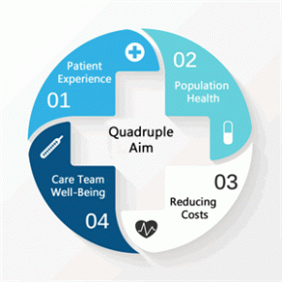
What is the Triple Aim?
The Triple Aim is an approach to optimizing health system performance, proposing that health care institutions simultaneously pursue 3 dimensions of performance: improving the health of populations, enhancing the patient experience of care, and reducing the per capita cost of health care. The primary Triple Aim goal is to improve the health of the population, with 2 secondary goals - improving patient experience and reducing costs - contributing to the achievement of the primary goal.
What is the Quadruple Aim?
Adds the forth dimension to the Triple Aim and incorporates improving the work life of those who deliver care to the compass point of better care, better health, and lower cost.
Without a focus on staff, achieving triple aim goals becomes even harder to achieve; however, if providers start implementing ways in which staff member’s lives can be made easier, patient care can be greatly enhanced.
Please visit the link for more information.
https://www.ncbi.nlm.nih.gov/pmc/articles/PMC4226781/

