Slide 1

Transitional Care Services
Focus Group and Q&A
Thursday, May 11, 2023
Eileen Egbo, Manager of Clinical Care Management
Erin Slack, Senior Manager of Population Health

Slide 2

Determining a patient’s PCP after SNF or Hospital Stay
Ask the Member to see their card. It is on the front.
  Medi-Cal Member ID – Members are assigned to a clinic system, not a PCP.
  For example, West Ventura Medical Clinic, but Members can see anyone from that clinic.
Call customer service - 1.888.301.1228 to request PCP information.
Discharge summary and/or facesheet from the hospital should contain the Member’s PCP information.

Slide 3
If a patient has no PCP, how do we get them established with one?
Hospital or SNF should be asking the Member this upon admission to the hospital or the facility.
PCP may not be assigned during the first month of enrollment, for newborns, or if the Member has dual coverage.
For a new Member or newborn, the member can see anyone that accepts Medi-Cal. Help the Member to find a provider in their neighborhood by calling 1.888.301.1228.
For dual coverage, there will be no PCP assigned on card.

Slide 4
Who do we call when a member does not have a place to go when they leave SNF or hospital or other service needs?
Community Support - Recuperative Care - All hospitals have access to the National Health Foundation portal.
SNFs need to refer to Whole Person Care
  Main Line: (805) 339-1122
  Fax: (805) 339-1128

Slide 5
What is the quickest and more appropriate way to get AUTH for the SNF or HH?
SNF - Case managers at hospital work with UM Discharge RN – Pre-Admission Screening and Resident Review (PASRR) must be completed to go from hospital to SNF.
Home Health - FAX an authorization request with clinical justification to (855) 883-1552; must have accepting HH agency.
We have an extensive provider network that can be accessed here: https://www.goldcoasthealthplan.org/provider-directory/
Focus on Member Choice and Continuity:
  Ask the member where they would like to go or if they have a previous relationship with a provider.

Slide 6
What are the “transitions of care” and how are they accessed?
When the UM nurse identifies someone with the SPD (Seniors and Persons with Disabilities) aid code, then a referral is made to GCHP care management to help support transitions of care.
Pilot with St. John’s – Hospital Home Navigators in the hospital

Slide 7
Do you have high risk case managers and what is the criteria to get one assigned?
Submit a care management referral for any Member for any reason.
To reach the GCHP Care Management Department, please call (805) 437-5656 or email CareManagement@goldchp.org.
Referral Form
Notes:
What do they do how do they help?
Would a patient who has no CG and no ability to care for themselves be an appropriate referral?

Slide 8
What help is available for members who need to navigate healthcare resources but do not meet criteria as a high-risk patient?
Submit a care management referral for any Member for any reason.
To reach the GCHP Care Management Department, please call (805) 437-5656 or email CareManagement@goldchp.org.
Referral Form

Slide 9
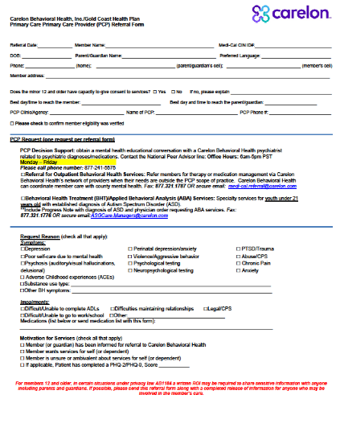
Behavioral health – what is Gold Coast’s algorithm for services and care?
The screening tool provides a means to determine if it’s nonspecialty (mild-moderate) or specialty (VCBH). If the member meets criteria, they can be referred to Carelon. (Or CM can help get them connected.) A score 0-5 means Carelon; scores 6 and higher are referred to VCBH.
Adult Screening Tool for Medi-Cal Mental Health Services
Youth Screening Tool for Medi-Cal Mental Health Services
Carelon referral form can be used for members who may need assistance getting connected to services.
VCBH crisis and referral line (866) 998-2243

Slide 10
Substance abuse – what is Gold Coast’s algorithm for services and care?
VCBH provides all levels of substance use treatment services. GCHP ensures that members are screened for substance use concerns and referred to the appropriate services, and CM can help connect members to services if needed.
https://www.vcbh.org/en/
(844) 385-9200
https://www.vcbh.org/en/programs-services/substance-use-services

Slide 11
How can we help make a warm handoff when the Gold Coast patient is ready to leave the hospital, SNF, or HH?
Request continued authorization as medically necessary.
Or submit a care management referral for any Member for any reason.
To reach the GCHP Care Management Department, please call (805) 437-5656 or email CareManagement@goldchp.org.
Referral Form

Slide 12
Questions for the Group –
Transitional Care Services
Does your facility have access to the GCHP Provider Portal?
Does your facility have the ability to transmit ADT (Admit, Discharge, Transfer) data through its electronic health record?
How do you envision the “warm hand-off” working for GCHP members? What role would your team members play in this process?
What do you see at the biggest challenge in supporting GCHP Members during a transition in care?
Notes:
A hospital cannot make an inpatient request

Slide 13
Questions for the Group –
Transitional Care Services
Do you currently make referrals to GCHP care management?
Do you currently make referrals to ECM or Whole Person Care?
What do you know about the currently available community supports and how to refer for them?
Notes:
A hospital cannot make an inpatient request

